Slide 1
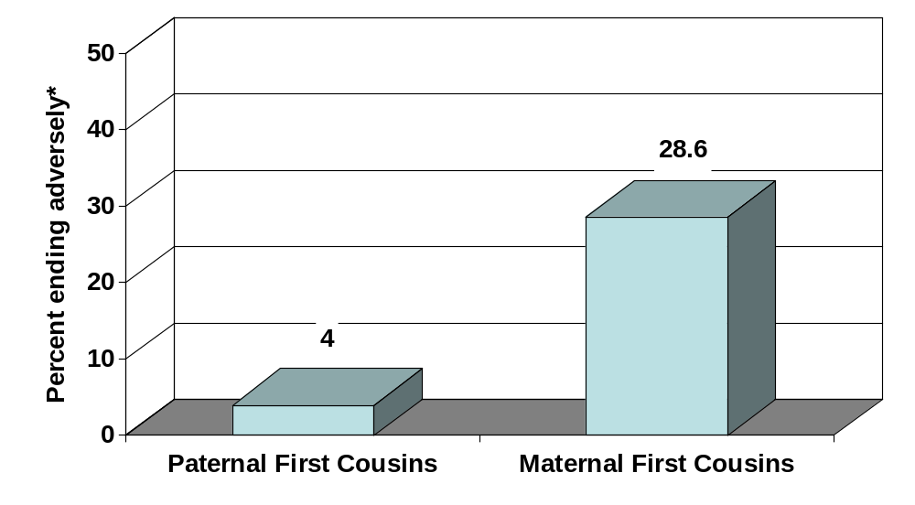
Maternal first cousin pregnancies were more likely to end adversely than paternal first cousin pregnancies (p<0.001)
(Byrne & Carolan, 2006)
*Adverse pregnancy outcomes included miscarriage, stillbirth and preterm delivery

